Slide 1
Data Mining
Find information from data
data
?
information

Slide 2
Data Mining
Find information from data
data
Questions
  What data → any data
  What information → anything useful
?
information

Slide 3
Data Mining
Find information from data
data
Questions
  What data → any data
  What information → anything useful
Characteristics
  Data is huge volume
  Computation is extremely intensive
?
information

Slide 4
Mining Association Rules
Department of Computer Science
Iowa State University
Ames, IA 50011

Slide 5
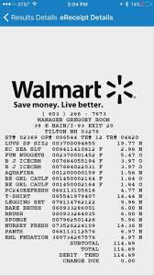
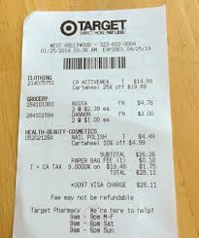
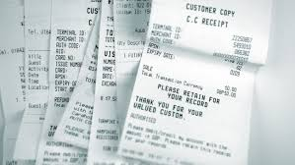
Basket Data
Retail organizations, e.g., supermarkets, collect and store massive amounts sales data, called basket data.
Each basket is a transaction, which consists of
  transaction date
  items bought

Slide 6
Association Rule: Basic Concepts
Given: (1) database of transactions, (2) each transaction is a list of items
Find: all rules that correlate the presence of one set of items with that of another set of items
  E.g., 98% of people who purchase tires and auto accessories also get automotive services done

Slide 7
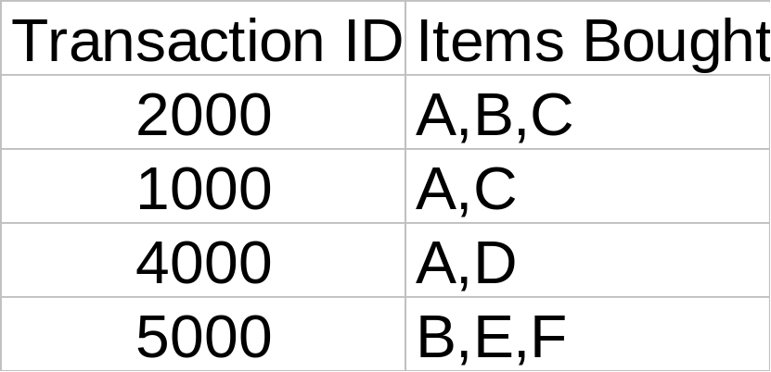
Rule Measures: Support and Confidence
Customer
buys both
Customer
buys diaper
Find all the rules X ⇒ Y with minimum support and confidence
  support, s, probability that a transaction contains {X, Y}
  confidence, c, conditional probability that a transaction having {X} also contains {Y}
Customer
buys beer
Let minimum support 50%, and minimum confidence 50%, we have
  A ⇒ C (50%, 66.6%)
  C ⇒ A (50%, 100%)

Slide 8
Applications
Basket data analysis, cross-marketing, catalog design, loss-leader analysis, clustering, classification, etc.
  Maintenance Agreement (What the store should do to boost Maintenance Agreement sales)
  Home Electronics (What other products should the store stocks up?)
  Attached mailing in direct marketing

Slide 9
Challenges
Finding all rules X→Y with minimum support and minimum confidence
  X could be any set of items
  Y could be any set of items
Naïve approach
  Enumerate all possible candidates X→Y
  For each candidate X→Y, compute its minimum support and minimum confidence
  Cost – given a database of m items, there will be 2^m different sets
    We have 2^m of X, 2^m of Y, and 2^m * 2^m of XY

Slide 10
Mining Frequent Itemsets: the Key Step
STEP1: Find the frequent itemsets: the sets of items that have minimum support
  The key step
STEP2: Use the frequent itemsets to generate association rules

Slide 11
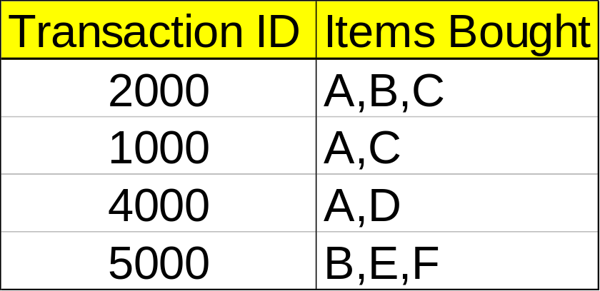
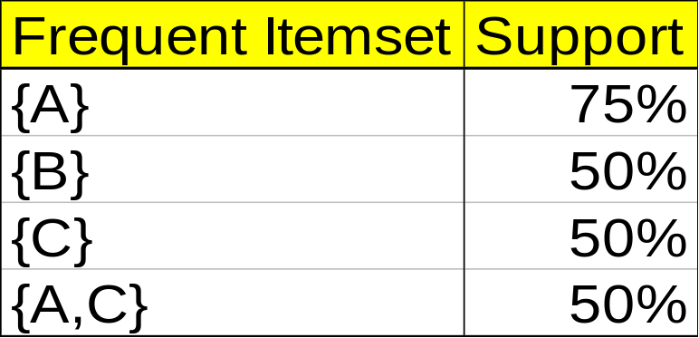
Mining Association Rules—An Example
STEP 1: Find the sets of items that have minimum support
Min. support 50%
Min. confidence 50%
STEP2: Use the frequent itemsets to generate association rules
For rule A ⇒ C :
  support = support({A , C}) = 50%
  confidence = support({A, C})/support({A}) = 66.6%

Slide 12
Mining Association Rules—An Example
Min. support 50%
Min. confidence 50%
  How to generate frequent itemset?

Slide 13
Apriori Principle
Any subset of a frequent itemset must also be a frequent itemset
  If {AB} is a frequent itemset, both {A} and {B} must be a frequent itemset
  If {AB} is not a frequent itemset, {ABX} cannot be a frequent itemset

Slide 14
Finding Frequent Itemsets
Iteratively find frequent itemsets with cardinality from 1 to k (k-itemset)
  Find frequent 1-itemsets
    {A}, {B}
  Find frequent 2-itemset
    {AX}, {BX}
  Find frequent 3-itemset
    {AXY}, {BXY}

Slide 15
The Apriori Algorithm
Pseudo-code:
    C_{k}: candidate itemset of size k
    L_{k} : frequent itemset of size k
    L₁ = {frequent items};
    for (k = 1; L_{k} !=∅; k++) do begin
    C_{k+1} = candidates generated from L_{k};
    for each transaction t in database do
      increment the count of all candidates in C_{k+1} contained in t
    L_{k+1} = candidates in C_{k+1} with min_support
    end
    return ∪_{k} L_{k};

Slide 16








The Apriori Algorithm — Example
Database D
L₁
C₁
Scan D
C₂
C₂
L₂
Scan D
C₃
Scan D
L₃

Slide 17
How to Generate Candidates?
Step 1: self-joining L_{k-1}
  Observation: all possible frequent k-itemsets can be generated by self-joining L_{k-1}
Step 2: pruning
  Observation: If any subset of an K-itemset is not a frequent itemset, the K-itemset cannot be frequent

Slide 18
Example of Generating Candidates
L₃={abc, abd, acd, ace, bcd}
Self-joining to find all 4-itemset: L₃*L₃
  abcd from abc and abd
  acde from acd and ace
Pruning:
  acde is removed because ade is not in L₃
C₄={abcd}

Slide 19
Generating Candidates: Pseudo Code
Suppose the items in L_{k-1} are listed in an order
Step 1: self-joining L_{k-1}
  insert into C_{k}
  select p.item₁, p.item₂, …, p.item_{k-1}, q.item_{k-1}
  from L_{k-1} p, L_{k-1} q
  where p.item₁=q.item₁, …, p.item_{k-2}=q.item_{k-2}, p.item_{k-1} < q.item_{k-1}
Step 2: pruning
  forall itemsets c in C_{k} do
    forall (k-1)-subsets s of c do
      if (s is not in L_{k-1}) then delete c from C_{k}

Slide 20
How to Count Supports of Candidates?
For each candidate frequent itemset, we need to count its support
  The number of transactions that contains S
Why counting supports of candidates a problem?
  The total number of candidates can be very huge
    It is too expensive to scan the whole database for each candidate
  The total number of transaction is very large, and one transaction may contain many candidates
    It is also expensive to check each transaction against the entire set of candidates
Proposed method
  Indexing candidate itemsets using hash-tree

Slide 21
Hash-Tree
Leaf node: contains a list of itemsets
Interior node: contains a hash table
  Each bucket points to another node
  Depth of root = 1
  Buckets of a node at depth d points to nodes at depth d+1
All itemsets are stored in leaf nodes
H
Depth=1
H
H
H

Slide 22
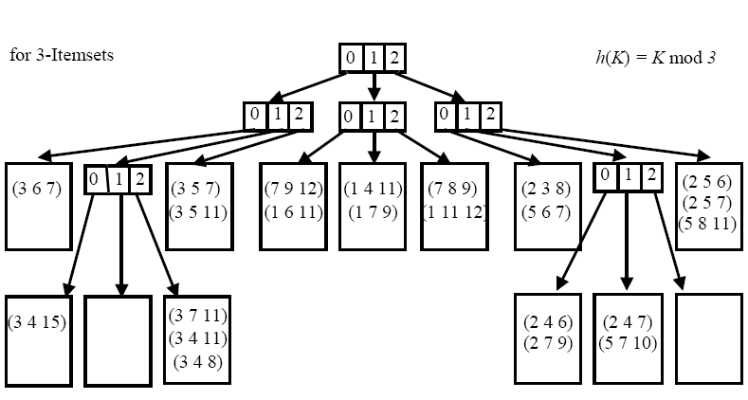
Hash-Tree: 3-itemset example
3-itemset (K1, K2, K3), where K1, K2, and K3 are ordered
Depth 1: hash(K1)
Depth 2: hash(K2)
Depth 3: hash(K3)
Notes:
When we add an itemset c, we start from the root and go down the tree until we reach a leaf.
At an interior node at depth d, we decide which branch to follow by applying a hash function to the dth item of the itemset.
All nodes are initially created as leaf nodes.
When the number of the itemsets in a leaf node exceeds a specified threshold, the leaf node is converted to an interior node.

Slide 23
Hash-Tree: 4-itemset example
Notes:
When we add an itemset c, we start from the root and go down the tree until we reach a leaf.
At an interior node at depth d, we decide which branch to follow by applying a hash function to the dth item of the itemset.
All nodes are initially created as leaf nodes.
When the number of the itemsets in a leaf node exceeds a specified threshold, the leaf node is converted to an interior node.
An example of hash-tree constructed for 4-itemset:
root
_________________|_________________________________
| | | |
bread cucumber onion parsley
| | | |
{bread, cucumber} {cucumber, onion} {onion, parsley} {parsley, tomato}
{bread, onion} {cucumber, parsley} {onion, tomato}
{bread, parsley} {cucumber, tomato}
{bread, tomato}

Slide 24
Hash-Tree: Construction
Searching for an itemset c:
  start from the root
  At depth d, to choose the branch to follow, apply a hash function to the d th item of c
Insertion of an itemset c
  Search for the corresponding leaf node
  Insert the itemset into that leaf
  If an overflow occurs:
    Transform the leaf node into an internal node
    Distribute the entries to the new leaf nodes according to the hash function
H
Depth=1
H
H
H
Notes:
The hash-tree constructed for C₂:
root
_________________|________________
| | | |
bread cucumber onion parsley
| | | |
{bread, cucumber} {cucumber, onion} {onion, parsley} {parsley, tomato}
{bread, onion} {cucumber, parsley} {onion, tomato}
{bread, parsley} {cucumber, tomato}
{bread, tomato}

Slide 25
Hash-Tree: Counting Support
Search for all candidate itemsets contained in a transaction T(t1, t2, …, tn) , where the items are sorted:
  At the root
    Determine the hash values for each item in T
    Continue the search in the resulting child nodes
  At an internal node at level d (reached after hashing of item t_{i})
    Determine the hash values and continue the search for each item t_{k} with K>I
  At a leaf node
    Check whether the itemsets in the leaf node are contained in transaction T
H
Depth=1
H
H
H

Slide 26
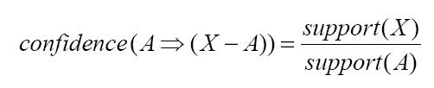
Generation of Rules from Frequent Itemsets
For each frequent itemset X:
  For each subset A of X, form a rule A➔(X - A)
  Compute the confidence of the rule
  Delete the rule if it does not have minimum confidence
Notes:
For any itemset c contained in transaction t,
the first item of c must be in t.
At root, by hashing on every item in t, we ensure that we only ignore itemsets that start with an item not in t.

Slide 27
Is Apriori Fast Enough? — Performance Bottlenecks
The core of the Apriori algorithm:
  Use frequent (k – 1)-itemsets to generate candidate frequent k-itemsets
  Use database scan and pattern matching to collect counts for the candidate itemsets
The bottleneck of Apriori: candidate generation
  Huge candidate sets:
    10⁴ frequent 1-itemset will generate 10⁷ candidate 2-itemsets
    To discover a frequent pattern of size 100, e.g., {a₁, a₂, …, a₁₀₀}, one needs to generate 2¹⁰⁰ ≈ 10³⁰ candidates.
  Multiple scans of database:
    Needs (n +1 ) scans, n is the length of the longest pattern

Slide 28
Summary
Association rule mining
  probably the most significant contribution from the database community in KDD
  A large number of papers have been published
An interesting research direction
  Association analysis in other types of data: spatial data, multimedia data, time series data, etc.

Slide 29
References
R. Agrawal, T. Imielinski, and A. Swami. Mining association rules between sets of items in large databases. SIGMOD'93, 207-216, Washington, D.C.
R. Agrawal and R. Srikant. Fast algorithms for mining association rules. VLDB'94 487-499, Santiago, Chile.

